Slide 1
Concepts in Programming (for Biologists)
Python Programming for Biologists Seminar Series
R. Burke Squires
NIAID BCBB

Slide 2
Outline
Why…
How…
…should you learn to program?
…do we have to program a computer?
…should someone learn python?
…can programming help you?
…does one program a computer?
…can you learn more?
Notes:
How Can Programming Help Us?
Why Do We Have To Program A Computer?
How Do You Program?
Which Language Do You Choose?
Where Do We Program / Ides
What Features Are A Help To Scientists
Development In The 21st Century
Devops
Becoming A Reproducible Scientist
On The Cutting Edge – Deep Learning

Slide 3
Learning Objectives
Enable you to…
compare computer hardware, software (program), and programming languages
communicate better with programmers, bioinformaticians
convert pseudocode to actual source code
make your research more reproducible
Enable you to “see” when a program would be useful
Enable you to think more clearly
Notes:
Update

Slide 4
Motivation

Slide 5
What Are Some Examples of How Programming Can Help?
Re-run an entire analysis on new data, (almost) instantly
“Glue” program output and input together into a single workflow
Test multiple parameters all at the same time
Download data from a known location and process it…automatically
Create, update, move, and/or rename files and folders easily
Create a web portal or graphical user interface for your software
…automate the boring stuff!

Slide 6
Why Should You Learn To Program?
Opportunities to make your research
FASTER - Repeat an entire analysis by just replacing the input
BETTER – Validate your analysis, use statistics
REPRODUCIBLE - Make your research (more) reproducible
MORE COMPETATIVE – many other researchers will be using these similar techniques

Slide 7
Challenges of Programming
Picking a programming language
Learning a programming language
Knowing which piece of the language to use
Debugging!!!
Remembering what the program does when you come back to it
Keeping track of different programs
Programing requires: Practice, practice, practice!

Slide 8
You Have (Probably) Programmed Before… and You May Not Even Know It?
Written a formula in Excel
Recorded a macro in Excel

Slide 9
Why Do We Need To Program Computers?

Slide 10
Computers
http://www.apple.com
Compute Cluster /
High-performance computer (HPC) /
Supercomputer
https://computing.llnl.gov/tutorials/linux_clusters/

Slide 11
How Do Computer Communicate?
Binary digit– 1, 0
Electrical impulses
“Bit”
“Byte”
8 bits (0s, 1s)
“Word”
64 bit (32 bit) – 8 bytes at a time
Width of communication path in central processing unit (CPU)
I7, i5, Xeon, Athlon
http://engineering.integrisgp.com/wp-content/uploads/2015/10/computer-speak.jpg

Slide 12
What Does This Mean For Us?

Slide 13
Programming Languages
How do we go from high-level languages to assembly?
Interpreter (Python, R)
Compiler (C, C++, Java)
We write program “source code”
Usually saved as a file
We “run” or “execute” program
http://www.hackersclub.io/single-post/2016/04/06/Scripting-vs-Coding-vs-Programming

Slide 14
Printing “Hello World!”
C++
#include <iostream>
int main()
{
std::count << "Hello World” << std::endl;
return 0;
}
Python
print(“Hello World!”)
Java
public class HelloWorld {
public static void main (String[] args) {
System.out.println("Hello World!");
}
}
R
print("Hello World!", quote = FALSE)

Slide 15
How To Write A Program?

Slide 16
How Do We Program?
Think About Your Workflow (Algorithm)
Write Pseudocode
Break down our task into smaller tasks
Describe the major components of our program
Does this sound difficult?
Let’s look at an example that I suspect most of us are familiar with…
Convert pseudo code into a program or “source code”
Write in a text file

Slide 17

An Example Workflow: Coffee
Who drinks coffee?
What does it take to make a pot or cup of coffee?
(I’m a French Press type of coffee drinker)

Slide 18
An Example Workflow: Coffee
What are the steps?
Is order important?

Slide 19
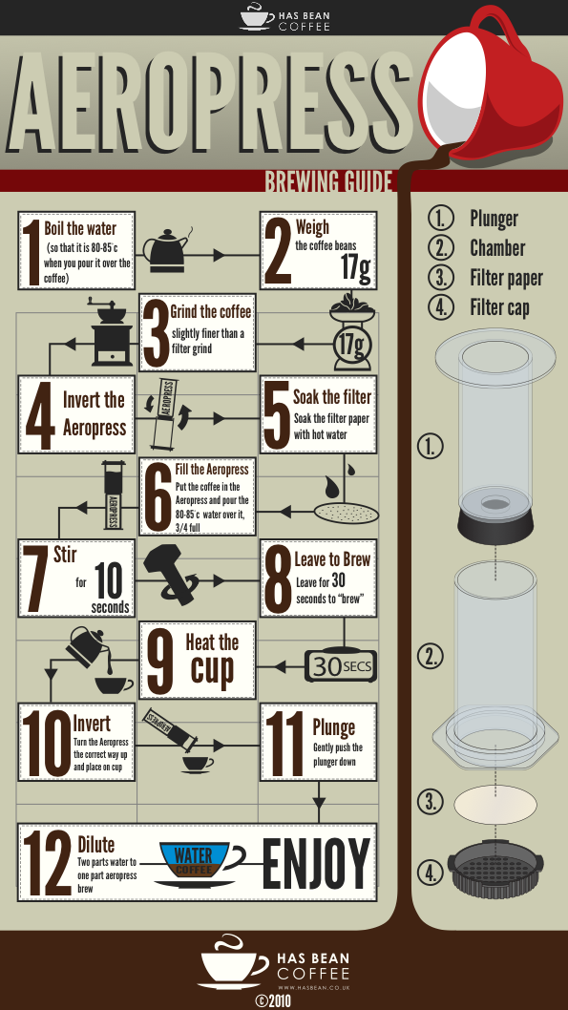
AeroPress…
Workflow…or…
Steps or
Recipe or
Protocol or
Flowchart…
Ultimately this is an algorithm

Slide 20
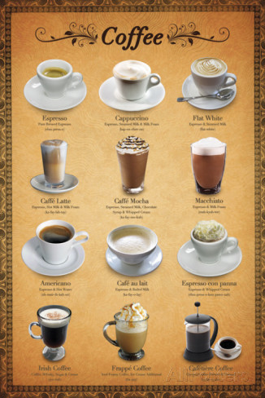
Coffee
What if I want to make different type of coffee drinks?
What is different about my recipe?
What is the same about my recipe?
Is reproducibility important?
What happens if you gave those exact instructions to a three year old?

Slide 21
Algorithm
?
Input =>
=> Output

Slide 22
A New Way Of Seeing The World
What we are really teaching is a new way of looking at a problem
See repetition in your work; have fun with it
Where have you all seen repetition in your work?
Find repetition even when it does not look like it; where is repetition hiding?
Reproducibility / reuse of code

Slide 23
Why Learn Python?

Slide 24
Why Learn to Program in Python
A general purpose, high-level language
Cross-platform and open source
An interpreted language (no need to compile)
Easy to read language
Powerful
Fast (with package numpy, etc)
“Batteries included” standard library
Great Community
Many package available
Lots of help and tutorials
Easy installation (with anaconda distribution)
Popular for data science

Slide 25
Python Scientific Computing Packages
Numpy – fast matrix calculations
Pandas – scientific data analysis
Matplotlib – a MATLAB-like plotting library
SageMath – linear algebra, combinatorics, calculus, and more
SciPy – a large library of scientific tools
Scikit-learn – Machine learning
Stats-model – Statistical analysis
Jupyter – Analysis notebook / collaboration
Conda / bioconda - installers

Slide 26
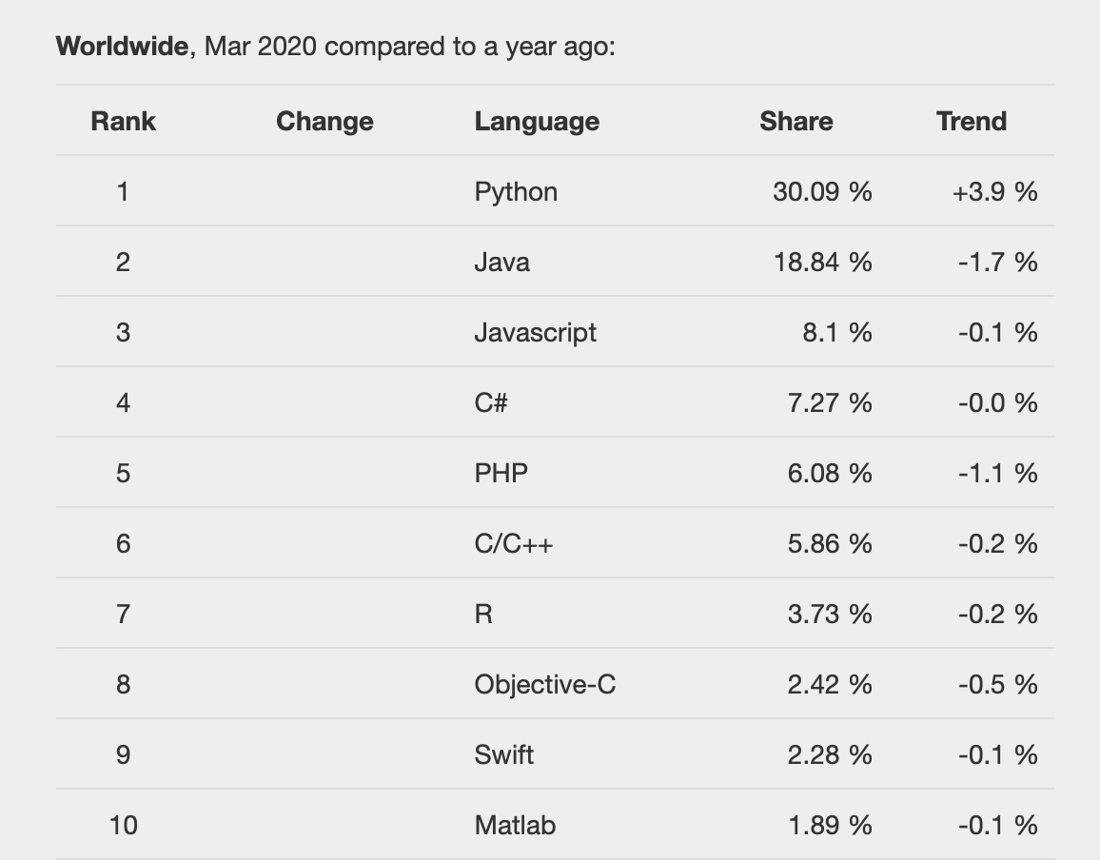
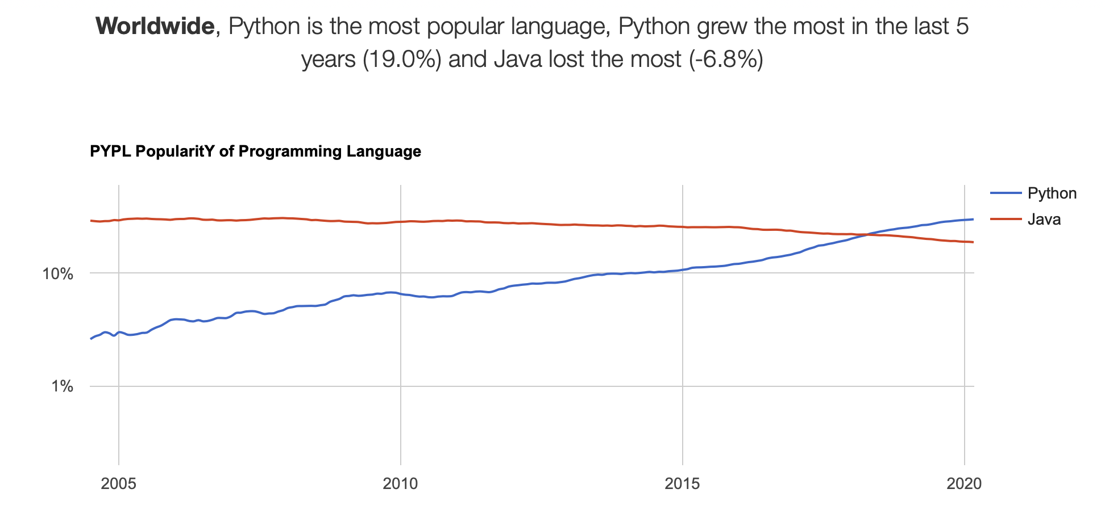
Language Popularity

Slide 27
What Are The Parts Of A Programming Language?

Slide 28
Writing Our Program
All programming languages share many of the same concepts
Data types
Data structures
Conditionals
Loops
Functions
Files input/output

Slide 29
Data Types
Integer
0, 1, 2, 999
Floating-point number, “Float”
3.14
Boolean
True, False
Character
“a”, “b”, “c”, “A”, “B”, “C”
String (of characters)
“ATCG”

Slide 30
Data Structures
Sequence Data Types
Array (List)
Ordered; duplicates allowed; can change
In python - [1, 2, 3], [ “A”, “B”, “C”]
Tuple
Ordered; duplicates allowed; cannot change
In python – tuple: (“a”, “t”, “g”, “c”);
Sets Data Types
Sets
Unordered; no duplicate elements
In python - Set(['John', 'Jane', 'Jack', 'Janice'])
Mapping Data Types
Hash (Dictionary)
Key / value pair
Unordered; no duplicate keys, can change
In python – { “BRCA1”: “cancer gene” }

Slide 31
Variables make use of data types and structures
Variables
Keywords / Reserved Words (python)
A specific string that stores a value during the runtime of a program
Refer to a place in memory where the value is held
Example
conc = 10
and
exec
not
assert
finally
or
break
for
pass
class
from
print
continue
global
raise
def
if
return
del
import
try
elif
in
while
else
is
with
except
lambda
yield

Slide 32
Operators
Definition
Order of Operators
An object that is capable of manipulating a value or operator
For example, in "1 + 2", the "1" and "2" are the operands and the plus symbol is the operator
Order | Operator | Name | Example
1 | = | Equals | a = b
2 | == | Equals | a == b
3 | != | Not equal | a != b
4 | + | Plus | a + b
5 | - | Minus | a - b
6 | / | Divide | a / b
7 | * | Times | a * b

Slide 33
Conditional Statements
Definition
Example(s)
A statement that is true only for certain values (conditions) of the variables or symbols
If conc == 10:
print(“Concentrations is 10 mm”)
else:
print(“Concentration is not 10 mm”)

Slide 34
Loops
For loop…
Execute a known number of times
While loop
Execute while some condition is met
# Measure some strings: ...
words = ['cat', 'window', 'defenestrate']
for w in words:
print(w, len(w))
def fib(n):
# write Fibonacci series up to n ""Print a Fibonacci series up to n."""
a, b = 0, 1
while a < n:
print(a, end=' ')
a, b = b, a+b
print()

Slide 35
Functions
Definition
Example
A basic task of a computer, especially one that corresponds to a single instruction from the user.
When an task needs to be performed more then once, it is a good opportunity to convert that code into a function
def multiply(num1, num2):
answer = num1 * num2
return answer

Slide 36
Input / Output
File I/O
Network (Socket) IO
Read a file
Text files
Binary files
Write a file
Text file
Binary file
Read from a socket / network connection
Write to a socket / network connection

Slide 37
How To Write a Program

Slide 38
The biggest mistake I see new programmers make is focusing on learning syntax instead of learning how to solve problems.
- V. Anton Spraul
(Author of “Think Like a Programmer:
An Introduction to Creative Problem Solving”)
https://medium.freecodecamp.org/how-to-think-like-a-programmer-lessons-in-problem-solving-d1d8bf1de7d2

Slide 39
What Should You Do When You Encounter A New Problem?
Understand
Plan
Divide
Divide again?
Stuck?
Debug
Reassess
Research
Practice
https://medium.freecodecamp.org/how-to-think-like-a-programmer-lessons-in-problem-solving-d1d8bf1de7d2

Slide 40
If you can’t explain something in simple terms, you don’t understand it.
— Richard Feynman

Slide 41
1. Understand
Know exactly what is being asked
Most hard problems are hard because you don’t understand them (hence why this is the first step)
How to know when you understand a problem?
When you can explain it in plain English
Therefore you should write down your problem, doodle a diagram, or tell someone else about it (or thing… some people use a rubber duck)
https://medium.freecodecamp.org/how-to-think-like-a-programmer-lessons-in-problem-solving-d1d8bf1de7d2

Slide 42
2. Plan
Don’t dive right into solving without a plan. Plan your solution!
Nothing can help you if you can’t write down the exact steps
In programming, this means don’t start programming straight away
To get a good plan, answer this question:
“Given input X, what are the steps necessary to return output Y?”
Side note:
Programmers have a great tool to help them with this… Comments!
https://medium.freecodecamp.org/how-to-think-like-a-programmer-lessons-in-problem-solving-d1d8bf1de7d2

Slide 43
3. Divide
This is the most important step of all!
Do not try to solve one big problem
Instead, break it into sub-problems.
Then, solve each sub-problem one by one. Begin with the simplest.
Simplest means you know the answer (or are closer to that answer).
After that, simplest means this sub-problem being solved doesn’t depend on others being solved.
Once you solved every sub-problem, connect the dots.
Connecting all your “sub-solutions” will give you the solution to the original problem. Congratulations!
https://medium.freecodecamp.org/how-to-think-like-a-programmer-lessons-in-problem-solving-d1d8bf1de7d2

Slide 44
3. Divide
“If I could teach every beginning programmer one problem-solving skill, it would be the ‘reduce the problem technique.’
For example, suppose you’re a new programmer and you’re asked to write a program that reads ten numbers and figures out which number is the third highest. For a brand-new programmer, that can be a tough assignment, even though it only requires basic programming syntax.
https://medium.freecodecamp.org/how-to-think-like-a-programmer-lessons-in-problem-solving-d1d8bf1de7d2

Slide 45
3. Divide, cont.
If you’re stuck, you should reduce the problem to something simpler. Instead of the third-highest number, what about finding the highest overall? Still too tough? What about finding the largest of just three numbers? Or the larger of two?
Reduce the problem to the point where you know how to solve it and write the solution. Then expand the problem slightly and rewrite the solution to match and keep going until you are back where you started.
V. Anton Spraul
https://medium.freecodecamp.org/how-to-think-like-a-programmer-lessons-in-problem-solving-d1d8bf1de7d2

Slide 46
4. Stuck?
Don’t worry though, friend. This happens to everyone!
The difference is the best programmers/problem-solvers are more curious about bugs/errors than irritated.
In fact, here are three things to try when facing a whammy:
Debug
Reassess
Research
https://medium.freecodecamp.org/how-to-think-like-a-programmer-lessons-in-problem-solving-d1d8bf1de7d2

Slide 47
4. Stuck?
Debug:
Go step by step through your solution trying to find where you went wrong. Programmers call this debugging (in fact, this is all a debugger does).
“The art of debugging is figuring out what you really told your program to do rather than what you thought you told it to do.”” — Andrew Singer
https://medium.freecodecamp.org/how-to-think-like-a-programmer-lessons-in-problem-solving-d1d8bf1de7d2

Slide 48
4. Stuck?
Reassess:
Take a step back. Look at the problem from another perspective. Is there anything that can be abstracted to a more general approach?
Side note:
Another way of reassessing is starting anew. Delete everything and begin again with fresh eyes. I’m serious. You’ll be dumbfounded at how effective this is.
https://medium.freecodecamp.org/how-to-think-like-a-programmer-lessons-in-problem-solving-d1d8bf1de7d2
Notes:
“Sometimes we get so lost in the details of a problem that we overlook general principles that would solve the problem at a more general level. […]The classic example of this, of course, is the summation of a long list of consecutive integers, 1 + 2 + 3 + … + n, which a very young Gauss quickly recognized was simply n(n+1)/2, thus avoiding the effort of having to do the addition.” — C. Jordan Ball

Slide 49
4. Stuck?
Research:
Google it. You read that right. No matter what problem you have, someone has probably solved it. Find that person’ solution. In fact, do this even if you solved the problem! (You can learn a lot from other people’s solutions).
Caveat
Don’t look for a solution to the big problem. Only look for solutions to sub-problems. Why? Because unless you struggle (even a little bit), you won’t learn anything. If you don’t learn anything, you wasted your time.
https://medium.freecodecamp.org/how-to-think-like-a-programmer-lessons-in-problem-solving-d1d8bf1de7d2

Slide 50
Practice
Don’t expect to be great after just one week. If you want to be a good problem-solver, solve a lot of problems!
Practice. Practice. Practice. It’ll only be a matter of time before you recognize that “this problem could easily be solved with <insert concept here>.”
https://medium.freecodecamp.org/how-to-think-like-a-programmer-lessons-in-problem-solving-d1d8bf1de7d2

Slide 51
Practice
How to practice? There are options out the wazoo!
Practicing “micro problem-solving.” For example, Peter Thiel plays chess, and Elon Musk plays video-games.
So, what you should do is find an outlet to practice. Something that allows you to solve many micro-problems (ideally, something you enjoy).
For example, try coding challenges. Every day, try to solve at least one challenge
https://medium.freecodecamp.org/how-to-think-like-a-programmer-lessons-in-problem-solving-d1d8bf1de7d2

Slide 52
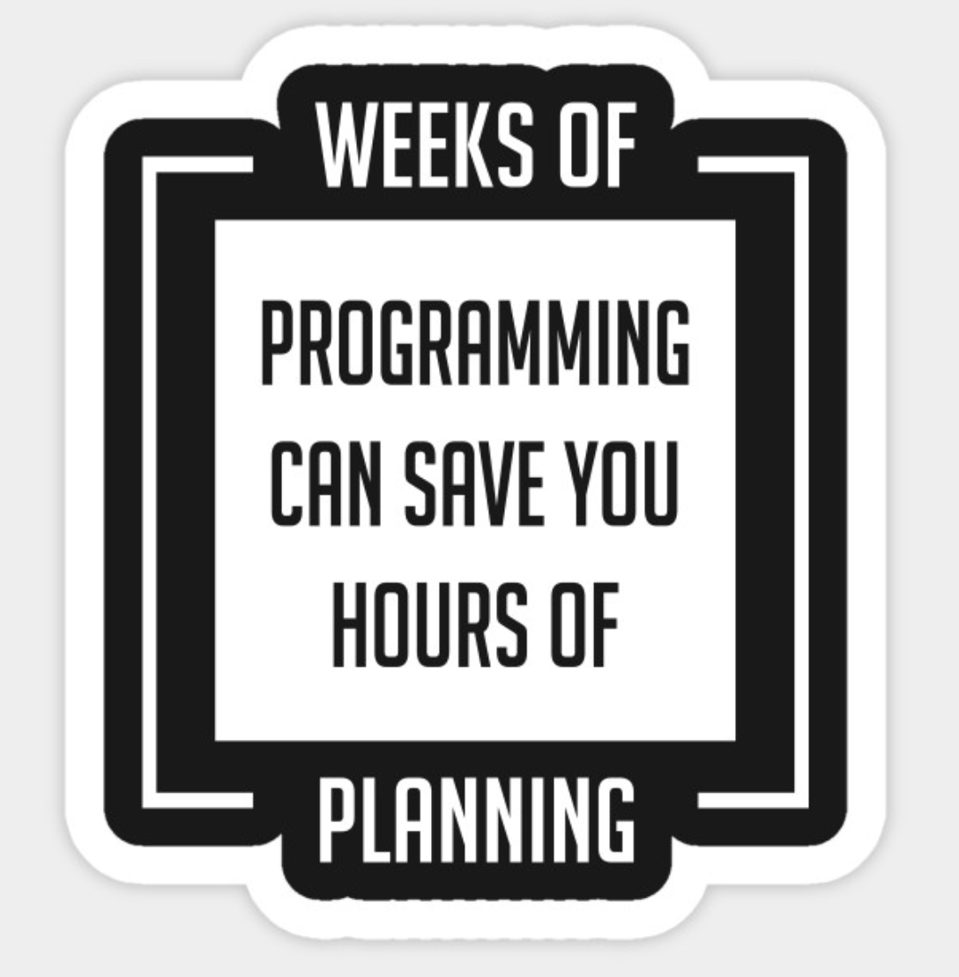
How To Write A Program
Think about the problem you want to solve
Outline the steps necessary to solve the problem
This is pseudocode
This is also your algorithm
Convert your pseudocode to real code
We will be writing our code in the python programming language
Run your code
Test your program

Slide 53
How Do We Get Started?
Create a workflow of what you want your program to do
Usually call this “pseudocode”
Pseudocode consists of
Clear natural human readable language
Three rules
Sequence of subtasks
choice (if)
repeat (while)
Later we will create pseudocode then convert it to actual code

Slide 54
Think About The Problem You Want To Solve
What are the data types you will need to use / manage?
How will you store your data (i.e. what data structures will you need to use?)
Are there any loops?
Are there any conditions?
Do you need to write any functions?

Slide 55
Debugging
Syntax – wrong grammar, i.e., breaking the rules of how to write the language
Forgetting punctuation, misspelling keyword
The program will not run at all with syntax errors
Logic - the program runs but does not produce the expected results
Using an incorrect formula, incorrect sequence of statements, etc.

Slide 56
How Do We Convert Pseudocode to an Actual Program?
Write your own code, all from scratch (…rarely)
Write your own code but use packages (
Modify existing code
Search for, adapt code written by some one else (…often)

Slide 57
Writing Our Program
Source code
Written in plain text
Write in
Text editor
Integrated development environment (IDE)
Jupyter Notebook
#!/usr/bin/python
# “This programs sums numbers given to it”
value = 1
sum = 0
print('Enter Numbers to add to the sum.')
print('Enter 0 to quit.')
while value != 0:
print('Current Sum:', sum)
a = float(input('Number? '))
sum = sum + value
print('Total Sum =', sum)

Slide 58
Code Is Read More Often Then It Is Written!

Slide 59
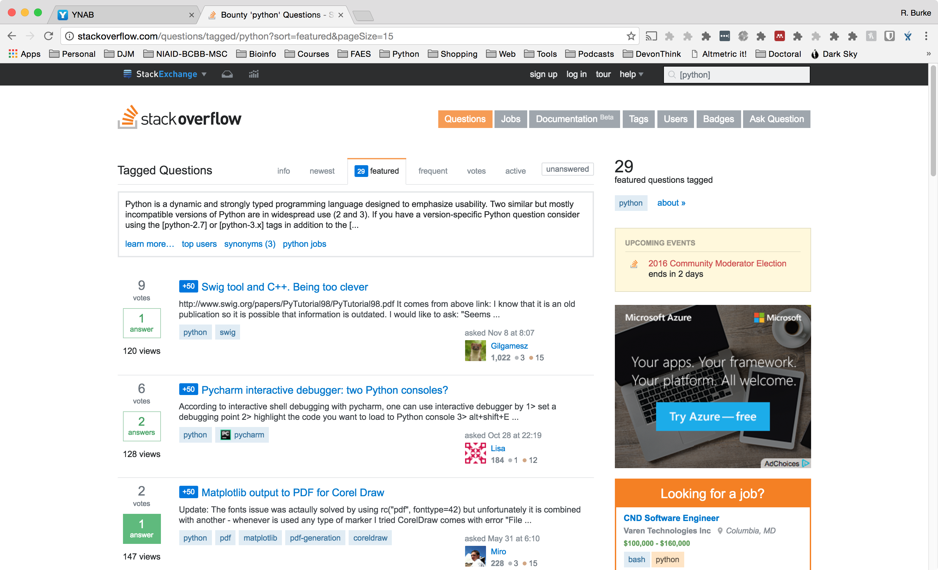
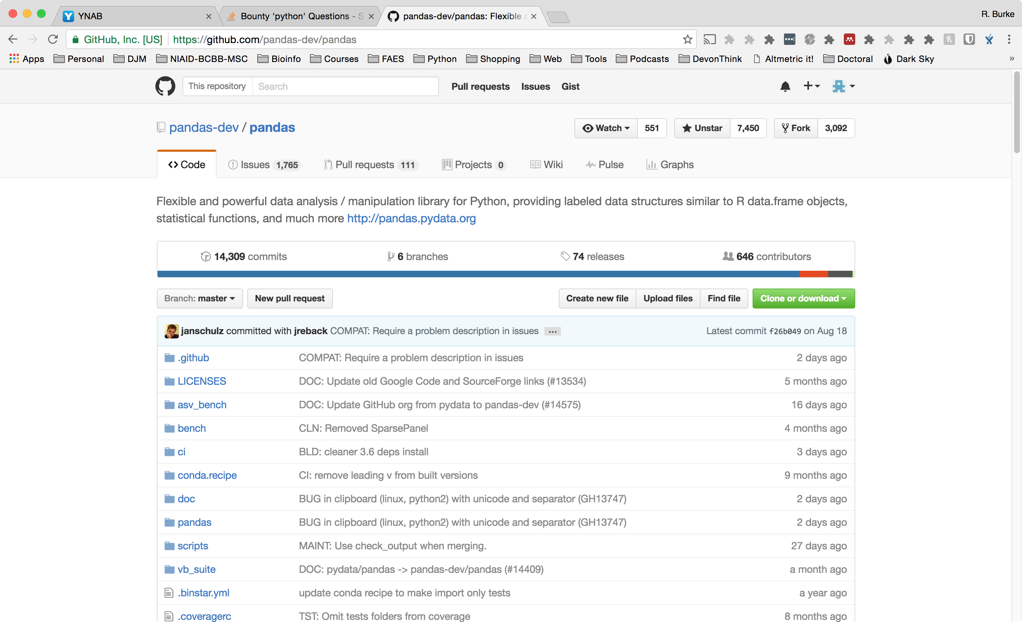
Where To Find Package or Code?
Your Previous Code
Other lab members code
Google Search
StackOverflow
GitHub (Open source, source code repository)
Programing language repository (python – pip, conda; R – cran)

Slide 60
How To Write Your Own Code?

Slide 61
How To Write Your Own Code?
Picking a Programming language
Usually the programming language most comfortable with
If you are new to programming, pick one of the languages that we see today
Pick the language that best fits the situation
Process
Start with pseudo code
Transform pseudo code into real code, one line at a time

Slide 62
Pseudocode Experiment

Slide 63
Learning Objectives
To familiarize you with computer programming, programming languages, scientific packages
Enable you to communicate better with programmers, bioinformaticians
Critique existing source code for your use
Assess which language that bests fits your needs
Facilitate you becoming a reproducible scientist
Notes:
Update

Slide 64
Resources
Algorithms
https://www.manning.com/books/grokking-algorithms
https://www.toptal.com/developers/sorting-algorithms
General python
https://docs.python.org/3/tutorial/index.html

